Slide 1

UNIVERSITY INSTITUTE OF COMPUTING
MASTER OF COMPUTER APPLICATIONS
DESIGN AND ANALYSIS OF ALGORITHMS
UNIT-3
DISCOVER . LEARN . EMPOWER

Slide 2
Dynamic Programming
Dynamic Programming is a general algorithm design technique for solving problems defined by or formulated as recurrences with overlapping sub instances.
Invented by American mathematician Richard Bellman in the 1950s to solve optimization problems.
Main idea:
set up a recurrence relating a solution to a larger instance to solutions of some smaller instances
solve smaller instances once
record solutions in a table
extract solution to the initial instance from that table

Slide 3
Dynamic Programming
  Dynamic Programming is an algorithm design technique for optimization problems: often minimizing or maximizing.
  Like divide and conquer, DP solves problems by combining solutions to sub problems.
  Unlike divide and conquer, sub problems are not independent.
  Sub problems may share sub problems, However, solution to one sub problem may not affect the solutions to other sub problems of the same problem.
  DP reduces computation by:
    Solving sub problems in a bottom-up fashion.
    Storing solution to a sub problem the first time it is solved.
    Looking up the solution when sub problem is encountered again.

Slide 4
Dynamic Programming VS. Other Approaches
Greedy Method—Only one decision sequence is ever generated.
Dynamic Programming—Many decision sequences may be generated.
Divide and Conquer—
Partition the problem into independent subproblems, solve the subproblems recursively and then combine their solutions to solve the original problem.
Dynamic Programming–
Applicable when the subproblems are not independent, that is, when subproblems share subsubproblems.
Solve every subsubproblem just once and then saves its answer in a table, thereby avoiding the work of recomputing the answer every time the subsubproblem is encountered.

Slide 5
Dynamic Programming
  Dynamic programming is a technique that breaks the problems into sub-problems, and saves the result for future purposes so that we do not need to compute the result again.
  The subproblems are optimized to optimize the overall solution is known as optimal substructure property.
  The main use of dynamic programming is to solve optimization problems.
  The dynamic programming guarantees to find the optimal solution of a problem if the solution exists.
  Dynamic programming is a technique for solving a complex problem by first breaking into a collection of simpler subproblems, solving each subproblem just once, and then storing their solutions to avoid repetitive computations.

Slide 6
Steps in Dynamic Programming
The following are the steps that the dynamic programming follows:
It breaks down the complex problem into simpler subproblems.
It finds the optimal solution to these sub-problems.
It stores the results of subproblems (memoization). The process of storing the results of subproblems is known as memorization.
It reuses them so that same sub-problem is calculated more than once.
Finally, calculate the result of the complex problem.

Slide 7
Multi-Stage Graph
• A Multistage graph is a directed graph.
• The nodes can be divided into a set of stages.
• All edges from a stage to next stage .
• There is no edge between vertices of same stage .
• A vertex of current stage to previous stage
In a multistage graph, a source and a destination, we need to find shortest path from source to destination.

Slide 8
Multistage Graphs
To find a shortest path in a multi-stage graph
Apply the greedy method :
The shortest path from S to T :
1 + 2 + 5 = 8
Fig. 3.1: Multistage Graph

Slide 9
Shortest Paths in Multi stage Graph
The greedy method can not be applied to this case: (S, A, D, T) 1+4+18 = 23.
The real shortest path is:
(S, C, F, T) 5+2+2 = 9.
Fig. 3.2: Implementation

Slide 10
Dynamic Programming
(Forward Approach)
d(S, T) = min{1+d(A, T), 2+d(B, T), 5+d(C, T)}
d(A,T) = min{4+d(D,T), 11+d(E,T)}
= min{4+18, 11+13} = 22.
Fig. 3.3: Dynamic Programming

Slide 11
Dynamic Programming
(Forward Approach) Contd…
d(B, T) = min{9+d(D, T), 5+d(E, T), 16+d(F, T)}
= min{9+18, 5+13, 16+2} = 18.
d(C, T) = min{ 2+d(F, T) } = 2+2 = 4
d(S, T) = min{1+d(A, T), 2+d(B, T), 5+d(C, T)}
= min{1+22, 2+18, 5+4} = 9.
The above way of reasoning is called forward reasoning.
Fig. 3.4: Forward Reasoning

Slide 12
Dynamic Programming
(Forward Approach) Contd…
d(S, A) = 1
d(S, B) = 2
d(S, C) = 5
d(S,D)=min{d(S,A)+d(A,D), d(S,B)+d(B,D)}
= min{ 1+4, 2+9 } = 5
d(S,E)=min{d(S,A)+d(A,E), d(S,B)+d(B,E)}
= min{ 1+11, 2+5 } = 7
d(S,F)=min{d(S,B)+d(B,F), d(S,C)+d(C,F)}
= min{ 2+16, 5+2 } = 7

Slide 13
Dynamic Programming
(Forward Approach) Contd…
d(S,T) = min{d(S, D)+d(D, T), d(S,E)+d(E,T), d(S, F)+d(F, T)}
= min{ 5+18, 7+13, 7+2 }
= 9

Slide 14
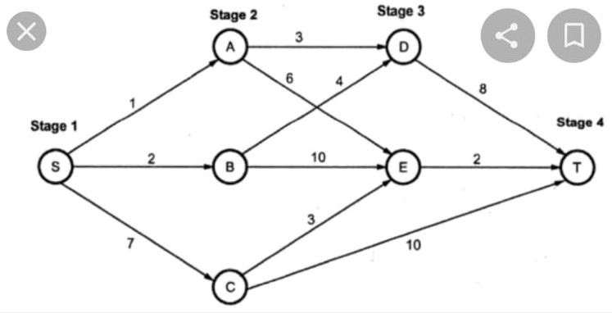
Multistage Graph
Find shortest path

Slide 15
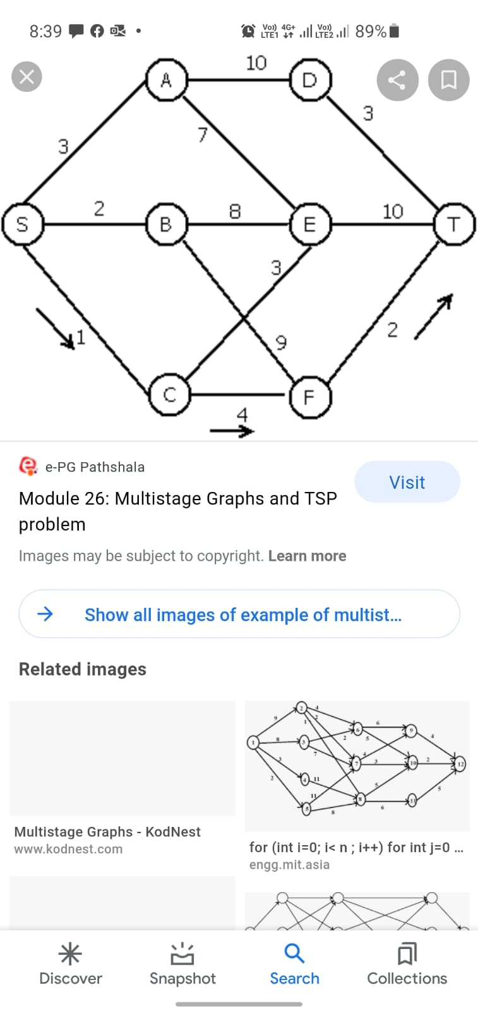
Multistage Graph
Find shortest path

Slide 16
Transitive Closure
Computes the transitive closure of a relation
(Alternatively: all paths in a directed graph)
Example of transitive closure:
3
3
1
0 0 1 0
1 0 0 1
0 0 0 0
0 1 0 0
1
0 0 1 0
1 1 1 1
0 0 0 0
1 1 1 1
4
4
2
2
Fig. 3.5: Transitive closure

Slide 17
Warshall’s Algorithm
Warshall's algorithm is used to determine the transitive closure of a directed graph or all paths in a directed graph by using the adjacency matrix. For this, it generates a sequence of n matrices. Where, n is used to describe the number of vertices.
R(0), ..., R(k-1), R(k), ... , R(n)
A sequence of vertices is used to define a path in a simple graph. In the k^{th} matrix (R^{(k)}), (r_{ij}^{(k)}), the element's definition at the i^{th} row and j^{th} column will be one if it contains a path from v_{i} to v_{j}.
The R⁽⁰⁾ matrix is used to describe the path without any intermediate vertices. So we can say that it is an adjacency matrix. The R^{(n)} matrix will contain ones if it contains a path between vertices with intermediate vertices from any of the n vertices of a graph. So we can say that it is a transitive closure.

Slide 18
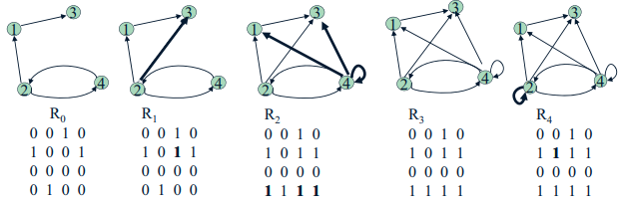
Warshall’s Algorithm
Main idea: a path exists between two vertices i, j, iff
• there is an edge from i to j; or
• there is a path from i to j going through vertex 1; or
• there is a path from i to j going through vertex 1 and/or 2; or
• there is a path from i to j going through vertex 1, 2, and/or 3; or
•...
• there is a path from i to j going through any of the other vertices

Slide 19
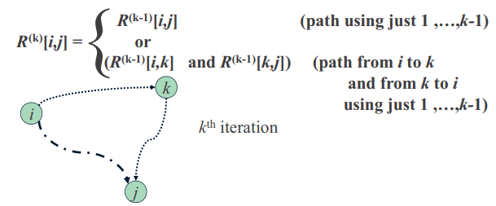
Warshall’s Algorithm
On the kth iteration, the algorithm determine if a path exists between two vertices i, j using just vertices among 1,…,k allowed as intermediate.

Slide 20
Warshall’s Algorithm
Recurrence relating elements R(k) to elements of R(k-1) is:
R(k)[i,j] = R(k-1)[i,j] or (R(k-1)[i,k] and R(k-1)[k,j])
It implies the following rules for generating R(k) from R(k-1):
Rule 1 If an element in row i and column j is 1 in R(k-1),
it remains 1 in R(k)
Rule 2 If an element in row i and column j is 0 in R(k-1),
it has to be changed to 1 in R(k) it has to be changed to 1 in R if and only if (k) if and only if the element in its row i and column k and the element in its column j and row k are both 1’s in R(k-1)

Slide 21
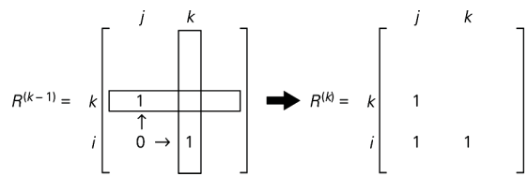
Warshall’s Algorithm
Rule for changing zeros in Warshall’s Algorithm

Slide 22
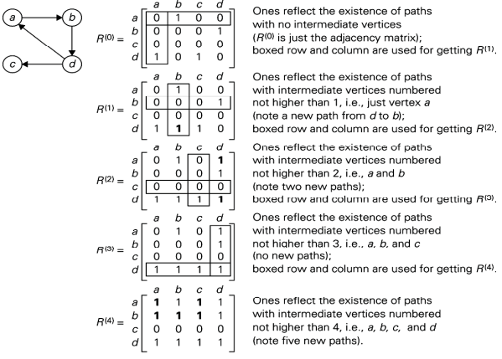
Warshall’s Algorithm
For R1,
Eg. R1(4,2)=R0(4,2) or R0(4,1) and R0(1,2)
R1(4,2)=0 or (1 and 1)
R1(4,2)=1

Slide 23
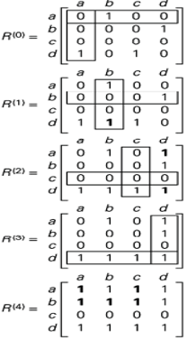
Warshall’s Algorithm
Here R(0) shows the adjacency matrix. In R(0), we can see the existence of a path, which has no intermediate vertices. We will get R(1) with the help of a boxed row and column in R(0).
In R(1), we can see the existence of a path, which has intermediate vertices. The number of the vertices is not greater than 1, which means just a vertex. It contains a new path from d to b. We will get R(2) with the help of a boxed row and column in R(1).
In R(2), we can see the existence of a path, which has intermediate vertices. The number of the vertices is not greater than 2, which means a and b. It contains two new paths. We will get R(3) with the help of a boxed row and column in R(2).
In R(3), we can see the existence of a path, which has intermediate vertices. The number of the vertices is not greater than 3, which means a, b and c. It does not contain any new paths. We will get R(4) with the help of a boxed row and column in R(3).
In R(4), we can see the existence of a path, which has intermediate vertices. The number of the vertices is not greater than 4, which means a, b, c and d. It contains five new paths.

Slide 24
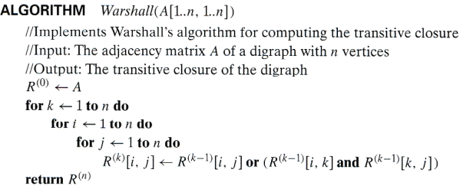
Warshall’s Algorithm
Time efficiency: (n3)
Space efficiency: Matrices can be written over their predecessors

Slide 25
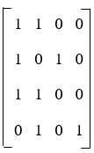
In this example, we will assume A = {1, 2, 3, 4} and let R be the relation on A whose matrix is described as follows:
Apply Warshall's Algorithm to path matrix.

Slide 26
Algorithms used to solve the All-Pairs Shortest Paths problem
Floyd–Warshall Algorithm
Johnson’s Algorithm
Matrix Multiplication Method

Slide 27
Floyd’s Algorithm:
All Pair Shortest Paths
In a weighted graph, find shortest paths between every pair of vertices
Same idea: construct solution through series of matrices D⁽⁰⁾, D⁽¹⁾, using an initial subset of the vertices as intermediate.
  In D^{(k)}, d_{ij}^{(k)}: weight of the shortest path from u_{i} to u_{j} with all intermediate vertices in an initial subset {u₁, u₂, … u_{k}}
Example:
4
3
1
1
6
1
5
4
2
3
Fig. 3.6: Floyd’s Implementation

Slide 28
Floyd’s Warshall Algorithm:
All Pair Shortest Paths
Floyd Warshall Algorithm is a famous algorithm.
It is used to solve All Pairs Shortest Path Problem.
It computes the shortest path between every pair of vertices of the given graph.
It is extremely simple and easy to implement.
Time Complexity-
Floyd Warshall Algorithm consists of three loops over all the nodes. Hence, the asymptotic complexity of Floyd Warshall algorithm is O(n³). Here, n is the number of nodes in the given graph.
Floyd Warshall Algorithm is an example of dynamic programming approach.
When Floyd Warshall Algorithm Is Used?
Floyd Warshall Algorithm is best suited for dense graphs.
This is because its complexity depends only on the number of vertices in the given graph.
For sparse graphs, Johnson’s Algorithm is more suitable.

Slide 29
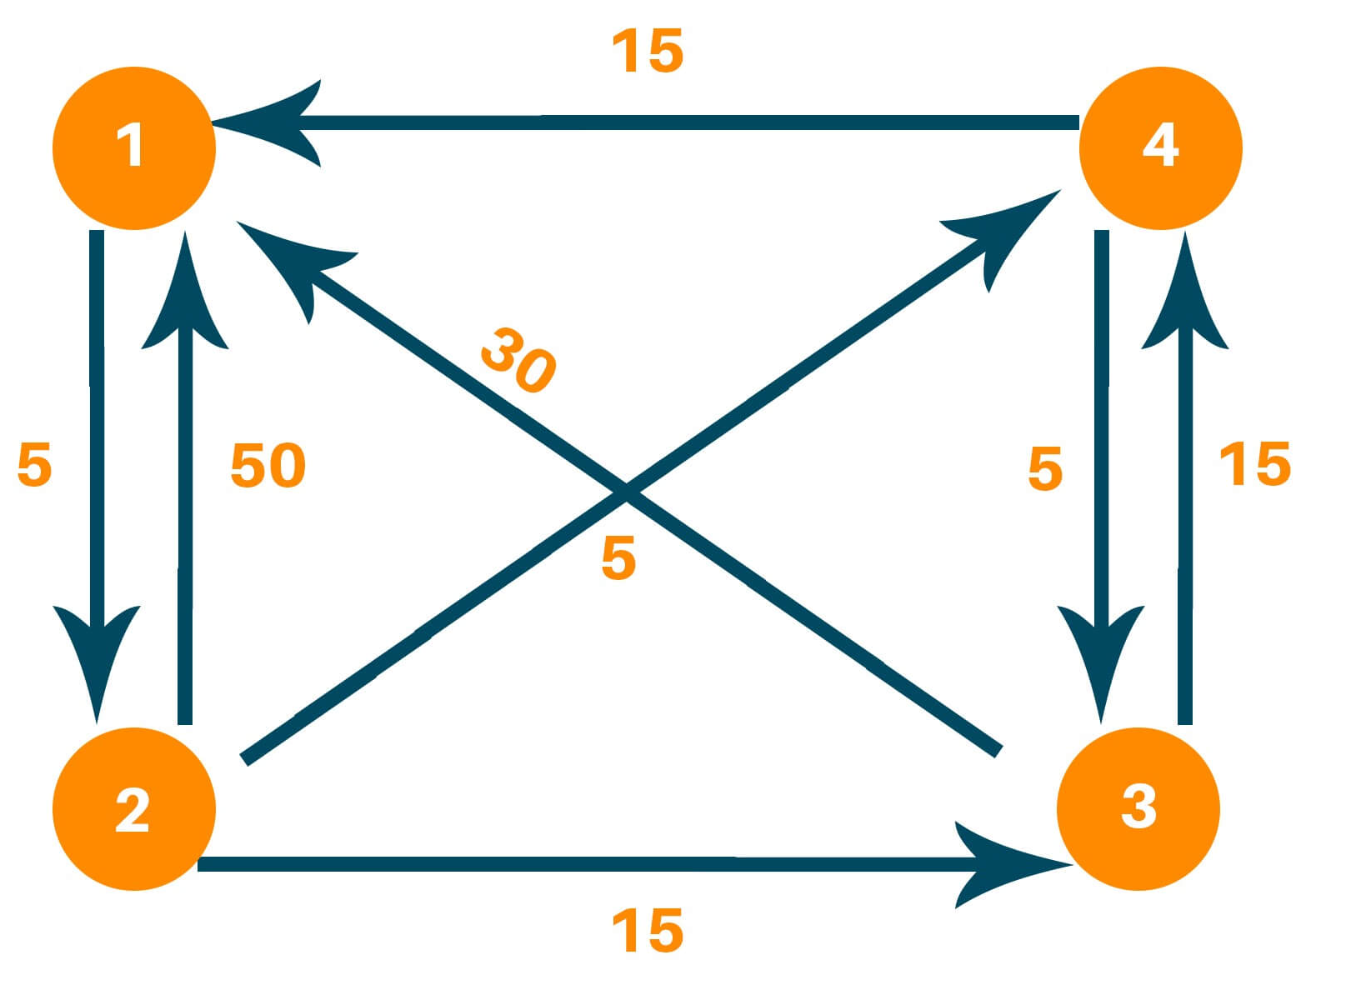
Floyd’s Warshall Algorithm:
Consider the following directed weighted graph-

Slide 30
Floyd’s Warshall Algorithm:
Step-01:
Remove all the self loops and parallel edges (keeping the lowest weight edge) from the graph.
In the given graph, there are neither self edges nor parallel edges.
Step-02:
Write the initial distance matrix.
It represents the distance between every pair of vertices in the form of given weights.
For diagonal elements (representing self-loops), distance value = 0.
For vertices having a direct edge between them, distance value = weight of that edge.
For vertices having no direct edge between them, distance value = ∞.

Slide 31
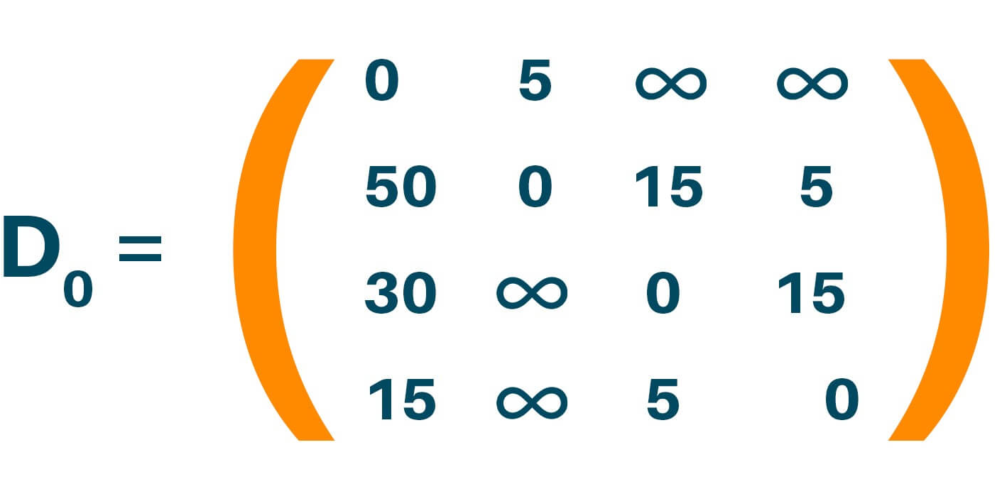
Floyd’s Warshall Algorithm:
Consider the following directed weighted graph-
Fig. 3.6: Floyd’s Implementation

Slide 32
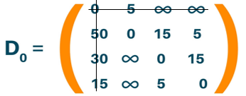
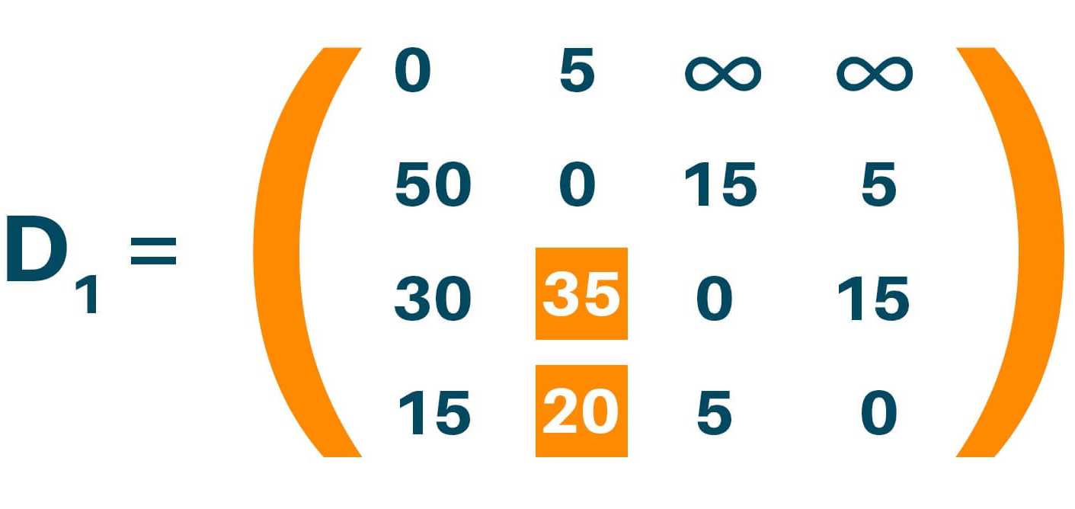
Floyd’s Warshall Algorithm:
Updating matrix D₁ which contains the distance between each node with ‘1’ as an intermediate node. Update distance if minimum distance value smaller than existing distance value found.
D_{k} [i , j] = min (D_{k-1} [i , j], D_{k-1} [i, k] + D_{k-1} [k , j])
D₁[3, 2] = min(D₁₋₁[3, 2], D₁₋₁ [3, 1] + D₁₋₁ [1 , 2])
D₁[3, 2] = min(Infinity, 35)
D_{k} [i , j] = min (D_{k-1} [i , j], D_{k-1} [i, k] + D_{k-1} [k , j])
D₁[4, 2] = min(D₁₋₁[4, 2], D₁₋₁ [4, 1] + D₁₋₁ [1 , 2])
D₁[4, 2] = min(Infinity, 20)
Here distance (3, 2) is updated from infinity to 35, and distance (4, 2) is updated from infinity to 20 as shown.

Slide 33
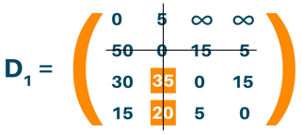
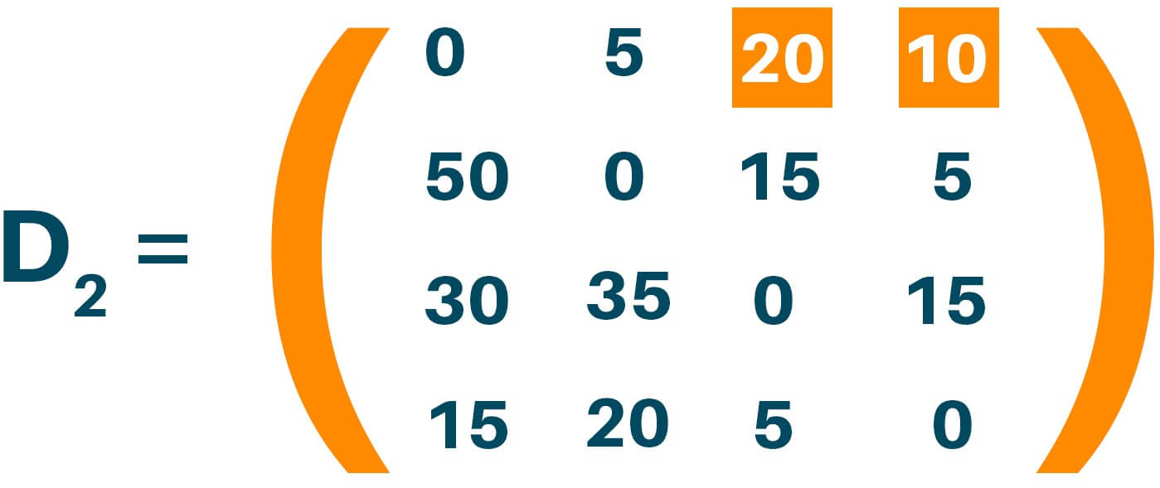
Floyd’s Warshall Algorithm:
Updating matrix D₂ contains the distance between two nodes with ‘2’ as an intermediate node.
D₂ [i , j] = min (D_{k-1} [i , j], D_{k-1} [i, k] + D_{k-1} [k , j])
D₂[1, 3] = min(D₂₋₁[1, 3], D₂₋₁ [1, 2] + D₂₋₁ [2 , 3])
D₂[1, 3] = min(Infinity, 20)
D_{k} [i , j] = min (D_{k-1} [i , j], D_{k-1} [i, k] + D_{k-1} [k , j])
D₂[1, 4] = min(D₂₋₁[1, 4], D₂₋₁ [1, 2] + D₂₋₁ [2 , 4])
D₂[1, 4] = min(Infinity, 10)
Update distance if minimum distance value smaller than existing distance value found. Here distance (1, 3) is updated from infinity to 20, and distance (1, 4) is updated from infinity to 10.

Slide 34
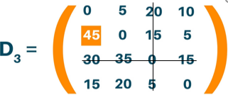
Floyd’s Warshall Algorithm:
Updating matrix D₃ contains the distance between two nodes with ‘3’ as an intermediate node.
D_{k} [i , j] = min (D_{k-1} [i , j], D_{k-1} [i, k] + D_{k-1} [k , j])
D₃[2, 1] = min(D₃₋₁[2, 1], D₃₋₁ [2, 3] + D₃₋₁ [3 , 1])
D₃[2, 1] = min(50, 45)
Update distance if minimum distance value smaller than existing distance value found. Here distance (2, 1) is updated from 50 to 45

Slide 35
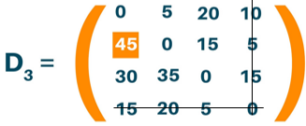
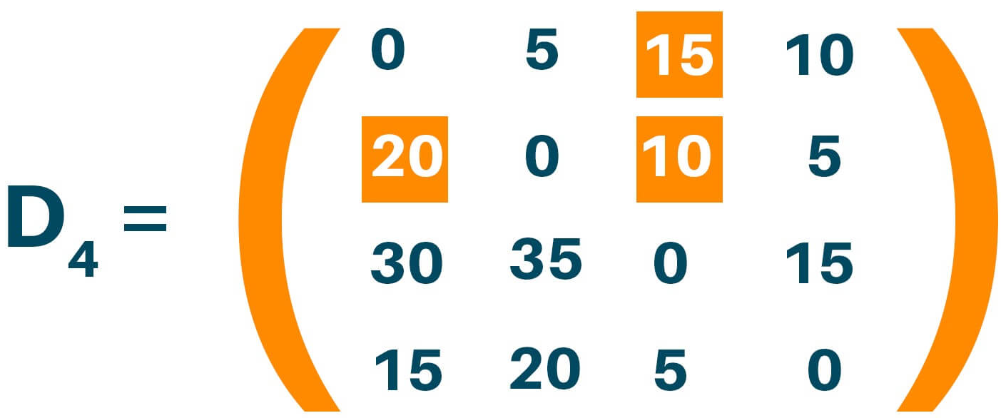
Floyd’s Warshall Algorithm:
Updating matrix D₄ contains the distance between two nodes with ‘4’ as an intermediate node. Update distance if minimum distance value smaller than existing distance value found.
D_{k} [i , j] = min (D_{k-1} [i , j], D_{k-1} [i, k] + D_{k-1} [k , j])
D₄[1, 3] = min(D₄₋₁[1, 3], D₄₋₁ [1, 4] + D₄₋₁ [4 , 3])
D₄[1, 3] = min(20, 15)
D_{k} [i , j] = min (D_{k-1} [i , j], D_{k-1} [i, k] + D_{k-1} [k , j])
D₄[2, 1] = min(D₄₋₁[2, 1], D₄₋₁ [2, 4] + D₄₋₁ [4 , 1])
D₄[1, 3] = min(45, 20)
D_{k} [i , j] = min (D_{k-1} [i , j], D_{k-1} [i, k] + D_{k-1} [k , j])
D₄[2, 3] = min(D₄₋₁[2, 3], D₄₋₁ [2, 4] + D₄₋₁ [4 , 3])
D₄[2, 3] = min(15, 10)
Here distance (1, 3) is updated from 20 to 15; distance (2, 1) is updated from 45 to 20, and distance (2, 3) is updated from 15 to 10

Slide 36
Optimal Binary Search Trees
In binary search tree, the nodes in the left subtree have lesser value than the root node and the nodes in the right subtree have greater value than the root node.
We know the key values of each node in the tree, and we also know the frequencies of each node in terms of searching means how much time is required to search a node. The frequency and key-value determine the overall cost of searching a node. The cost of searching is a very important factor in various applications. The overall cost of searching a node should be less.
The time required to search a node in BST is more than the balanced binary search tree as a balanced binary search tree contains a lesser number of levels than the BST. There is one way that can reduce the cost of a binary Search Tree is known as an optimal binary search tree.

Slide 37
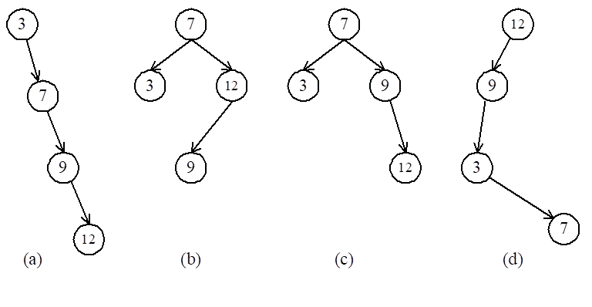
Optimal Binary Search Trees
e.g. binary search trees for 3, 7, 9, 12;

Slide 38
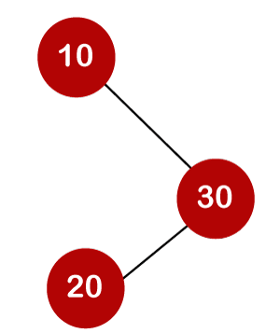
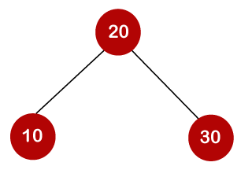
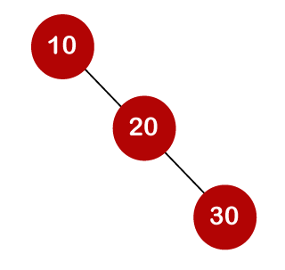
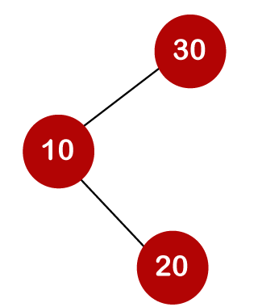
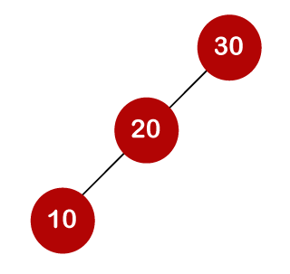
Optimal Binary Search Trees
For example: 10, 20, 30 are the keys, and the following are the binary search trees that can be made out from these keys.

Slide 39
Optimal Binary Search Trees
Key 10, 20, 30
Frequency 3, 2, 5
1*3
1*3
1*3
2*2
2*5
2*3
2*5
3*5
18
3*2
18
19
1*5
1*5
2*3
2*2
3*3
3*2
18
17

Slide 40
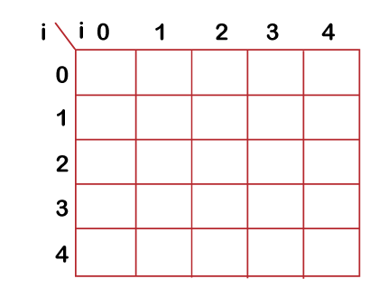
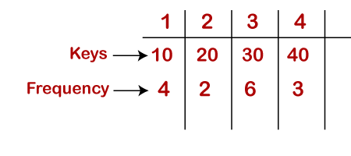
Optimal Binary Search Trees
Dynamic Approach
Consider the below table, which contains the keys and frequencies.

Slide 41
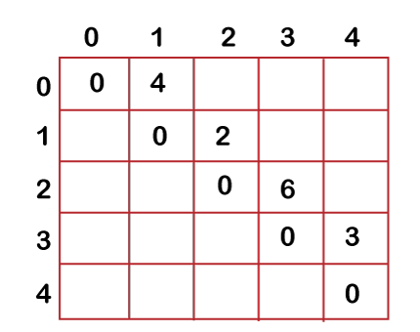
Optimal Binary Search Trees
First, we will calculate the values where j-i is equal to zero.
When i=0, j=0, then j-i = 0
When i = 1, j=1, then j-i = 0
When i = 2, j=2, then j-i = 0
When i = 3, j=3, then j-i = 0
When i = 4, j=4, then j-i = 0
Therefore, c[0, 0] = 0, c[1 , 1] = 0, c[2,2] = 0, c[3,3] = 0, c[4,4] = 0
Now we will calculate the values where j-i equal to 1.
When j=1, i=0 then j-i = 1
When j=2, i=1 then j-i = 1
When j=3, i=2 then j-i = 1
When j=4, i=3 then j-i = 1
Now to calculate the cost, we will consider only the jth value.
The cost of c[0,1] is 4 (The key is 10, and the cost corresponding to key 10 is 4).
The cost of c[1,2] is 2 (The key is 20, and the cost corresponding to key 20 is 2).
The cost of c[2,3] is 6 (The key is 30, and the cost corresponding to key 30 is 6)
The cost of c[3,4] is 3 (The key is 40, and the cost corresponding to key 40 is 3)

Slide 42
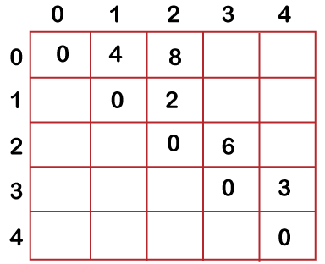
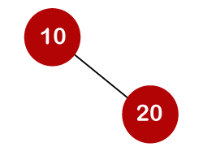
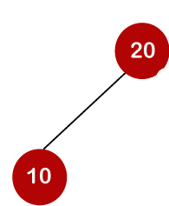
Optimal Binary Search Trees
Now we will calculate the values where j-i = 2
When j=2, i=0 then j-i = 2
When j=3, i=1 then j-i = 2
When j=4, i=2 then j-i = 2
In this case, we will consider two keys.
When i=0 and j=2, then keys 10 and 20. There are two possible trees that can be made out from these two keys shown below:
In the first binary tree, cost would be: 4*1 + 2*2 = 8
In the second binary tree, cost would be: 4*2 + 2*1 = 10
The minimum cost is 8; therefore, c[0,2] = 8
C[0,2]=min{c(0,0)+c(1,2) , c(0,1)+c(2,2)}+w(0,2)
=min{0+2 , 4+0}+6
=2+6=8
C[0,2]=8
w[0,2]=w(1)+w(2)=4+2=6

Slide 43
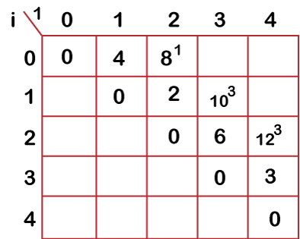
Optimal Binary Search Trees
When i=1 and j=3, then keys 20 and 30. There are two possible trees that can be made out from these two keys shown below:
C[1,3]=min{c(1,1)+c(2,3) , c(1,2)+c(3,3)}+w(1,3)
=min{0+6 , 2+0}+8
=2+8=10
When i=2 and j=4, we will consider the keys at 3 and 4, i.e., 30 and 40. There are two possible trees that can be made out from these two keys shown as below:
C[2,4]=min{c(2,2)+c(3,4) , c(2,3)+c(4,4)}+w(2,4)
=min{0+3,6+0}+9
=3+9=12
w[1,3]=w(2)+w(3)=2+6=8
w[2,4]=w(3)+w(4)=6+3=9

Slide 44
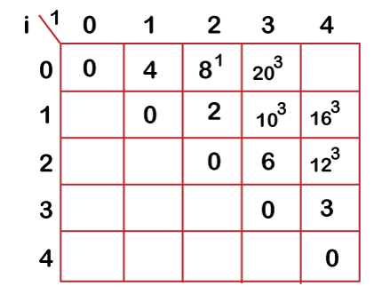
Optimal Binary Search Trees
Now we will calculate the values when j-i = 3
When j=3, i=0 then j-i = 3
When j=4, i=1 then j-i = 3
When i=0, j=3 then we will consider three keys, i.e.,10, 20 and 30.
C[0,3]=min{c(0,0)+c(1,3),c(0,1)+c(2,3), c(0,2)+c(3,3)}+w(0,3)
=min{0+10 , 4+6, 8+0}+12
=8+12=20
When i=1 and j=4 then we will consider the keys 20, 30, 40
c[1,4] = min{ c(1,1)+c(2,4), c(1,2)+c(3,4), c(1,3)+c(4,4)}+11
= min{0+12, 2+3, 10+0}+ 11
= min{12, 5, 10} + 11
=5+11=16
w[0,3]=w(1)+w(2)+w(3)=4+2+6=12
w[1,4]=w(2)+w(3)+w(4)=2+6+3=11

Slide 45
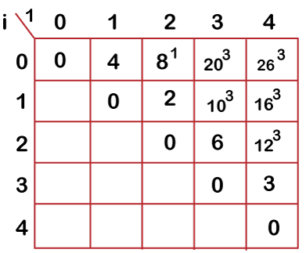
Optimal Binary Search Trees
Now we will calculate the values when j-i = 4
When j=4 and i=0 then j-i = 4
In this case, we will consider four keys, i.e., 10, 20, 30 and 40. The frequencies of 10, 20, 30 and 40 are 4, 2, 6 and 3 respectively.
w[0, 4] = 4 + 2 + 6 + 3 = 15
C[0,4]=min{c(0,0)+c(1,4) , c(0,1)+c(2,4), c(0,2)+c(3,4), c(0,3)+c(4,4)} + w(0,4)
=min{0+16 , 4+12 , 8+3 , 20+0}+15
=11+15=26

Slide 46
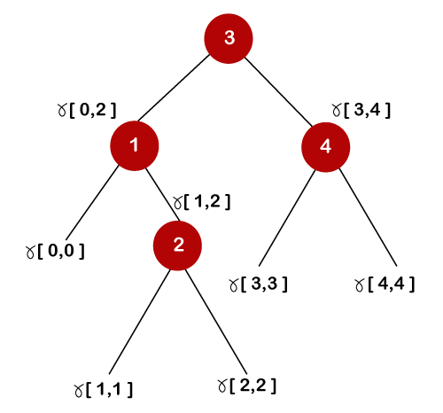
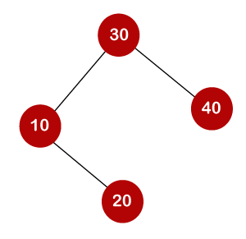
Optimal Binary Search Trees
The optimal binary tree can be created as:

Slide 47
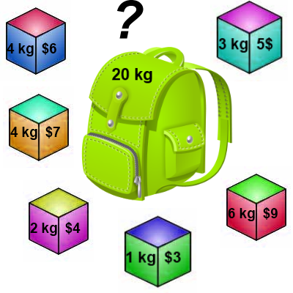
0-1 Knapsack Problem
You are given the following-
A knapsack (kind of shoulder bag) with limited weight capacity.
Few items each having some weight and value.
The problem states-
Which items should be placed into the knapsack such that-
The value or profit obtained by putting the items into the knapsack is maximum.
And the weight limit of the knapsack does not exceed.

Slide 48
0-1 Knapsack Problem Contd…
Knapsack problem has the following two variants-
Fractional Knapsack Problem
0/1 Knapsack Problem

Slide 49
Recurrence relation for the 0/1 Knapsack Problem
Using dynamic programming, we use recurrence relation and memorization concept to solve 0/1 knapsack problem.

Slide 50
0-1 Knapsack Problem Contd…
In 0/1 Knapsack Problem,
As the name suggests, items are indivisible here.
We can not take the fraction of any item.
We have to either take an item completely or leave it completely.
It is solved using dynamic programming approach.

Slide 51
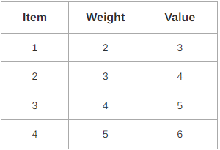
0-1 Knapsack Problem Contd…
Problem-
For the given set of items and knapsack capacity = 5 kg, find the optimal solution for the 0/1 knapsack problem making use of dynamic programming approach.
OR
Find the optimal solution for the 0/1 knapsack problem making use of dynamic programming approach. Consider-
n = 4
w = 5 kg
(w1, w2, w3, w4) = (2, 3, 4, 5)
(b1, b2, b3, b4) = (3, 4, 5, 6)

Slide 52
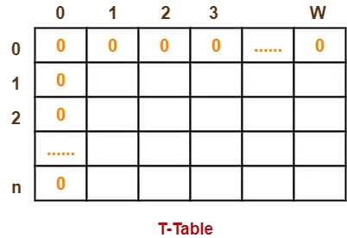
Knapsack weight capacity = w
Number of items each having some weight and value = n
0/1 knapsack problem is solved using dynamic programming in the following steps-
Step-01:
Draw a table say ‘T’ with (n+1) number of rows and (w+1) number of columns.
Fill all the boxes of 0th row and 0th column with zeroes as shown-
Step-02:
Start filling the table row wise top to bottom from left to right.
Use the following formula- T (i , j) = max { T ( i-1 , j ) , T( i-1 , j – weight[i]+P[i] }
Here, T(i , j) = maximum value of the selected items if we can take items 1 to i and have weight restrictions of j.
This step leads to completely filling the table.
Then, value of the last box represents the maximum possible value that can be put into the knapsack.
Step-03:
To identify the items that must be put into the knapsack to obtain that maximum profit,
Consider the last column of the table.
Start scanning the entries from bottom to top. On encountering an entry whose value is not same as the value stored in the entry immediately above it, mark the row label of that entry. After all the entries are scanned, the marked labels represent the items that must be put into the knapsack.

Slide 53
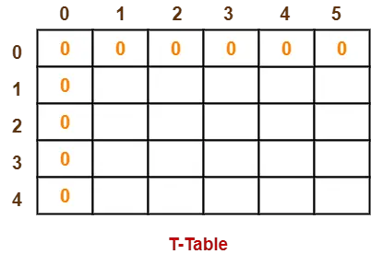
0-1 Knapsack Problem Contd…
Knapsack capacity (w) = 5 kg
Number of items (n) = 4
Step-01:
Draw a table say ‘T’ with (n+1) = 4 + 1 = 5 number of rows and (w+1) = 5 + 1 = 6 number of columns.
Fill all the boxes of 0th row and 0th column with 0.

Slide 54
0-1 Knapsack Problem Contd…
Step-02:
Start filling the table row wise top to bottom from left to right using the formula-
T (i , j) = max { T ( i-1 , j ) ,T( i-1 , j – weight[i])+P[i] }
Finding T(1,1)-
We have,
i = 1
j = 1
(value)i = (value)1 = 3
(weight)i = (weight)1 = 2
Substituting the values, we get-
T(1,1) = max { T(1-1 , 1) , T(1-1 , 1-2) + 3}
T(1,1) = max { T(0,1) , T(0,-1) + 3 }
T(1,1) = T(0,1) { Ignore T(0,-1) }
T(1,1) = 0

Slide 55
0-1 Knapsack Problem Contd…
Step-02:
Finding T(1,2)-
We have,
i = 1
j = 2
(value)i = (value)1 = 3
(weight)i = (weight)1 = 2
Substituting the values, we get-
T(1,2) = max { T(1-1 , 2) , 3 + T(1-1 , 2-2) }
T(1,2) = max { T(0,2) , 3 + T(0,0) }
T(1,2) = max {0 , 3+0}
T(1,2) = 3
Finding T(1,3)-
We have,
i = 1
j = 3
(value)i = (value)1 = 3
(weight)i = (weight)1 = 2
Substituting the values, we get-
T(1,3) = max { T(1-1 , 3) , 3 + T(1-1 , 3-2) }
T(1,3) = max { T(0,3) , 3 + T(0,1) }
T(1,3) = max {0 , 3+0}
T(1,3) = 3

Slide 56
0-1 Knapsack Problem Contd…
Step-02:
Finding T(1,4)-
We have,
i = 1
j = 4
(value)i = (value)1 = 3
(weight)i = (weight)1 = 2
Substituting the values, we get-
T(1,4) = max { T(1-1 , 4) , 3 + T(1-1 , 4-2) }
T(1,4) = max { T(0,4) , 3 + T(0,2) }
T(1,4) = max {0 , 3+0}
T(1,4) = 3
Finding T(1,5)-
We have,
i = 1
j = 5
(value)i = (value)1 = 3
(weight)i = (weight)1 = 2
Substituting the values, we get-
T(1,5) = max { T(1-1 , 5) , 3 + T(1-1 , 5-2) }
T(1,5) = max { T(0,5) , 3 + T(0,3) }
T(1,5) = max {0 , 3+0}
T(1,5) = 3

Slide 57
0-1 Knapsack Problem Contd…
Step-02:
Finding T(2,1)-
We have,
i = 2
j = 1
(value)i = (value)2 = 4
(weight)i = (weight)2 = 3
Substituting the values, we get-
T(2,1) = max { T(2-1 , 1) , 4 + T(2-1 , 1-3) }
T(2,1) = max { T(1,1) , 4 + T(1,-2) }
T(2,1) = T(1,1) { Ignore T(1,-2) }
T(2,1) = 0
Finding T(2,2)-
We have,
i = 2
j = 2
(value)i = (value)2 = 4
(weight)i = (weight)2 = 3
Substituting the values, we get-
T(2,2) = max { T(2-1 , 2) , 4 + T(2-1 , 2-3) }
T(2,2) = max { T(1,2) , 4 + T(1,-1) }
T(2,2) = T(1,2) { Ignore T(1,-1) }
T(2,2) = 3

Slide 58
0-1 Knapsack Problem Contd…
Step-02:
Finding T(2,3)-
We have,
i = 2
j = 3
(value)i = (value)2 = 4
(weight)i = (weight)2 = 3
Substituting the values, we get-
T(2,3) = max { T(2-1 , 3) , 4 + T(2-1 , 3-3) }
T(2,3) = max { T(1,3) , 4 + T(1,0) }
T(2,3) = max { 3 , 4+0 }
T(2,3) = 4
Finding T(2,4)-
We have,
i = 2
j = 4
(value)i = (value)2 = 4
(weight)i = (weight)2 = 3
Substituting the values, we get-
T(2,4) = max { T(2-1 , 4) , 4 + T(2-1 , 4-3) }
T(2,4) = max { T(1,4) , 4 + T(1,1) }
T(2,4) = max { 3 , 4+0 }
T(2,4) = 4

Slide 59
0-1 Knapsack Problem Contd…
Step-02:
Finding T(2,5)-
We have,
i = 2
j = 5
(value)i = (value)2 = 4
(weight)i = (weight)2 = 3
Substituting the values, we get-
T(2,5) = max { T(2-1 , 5) , 4 + T(2-1 , 5-3) }
T(2,5) = max { T(1,5) , 4 + T(1,2) }
T(2,5) = max { 3 , 4+3 }
T(2,5) = 7

Slide 60
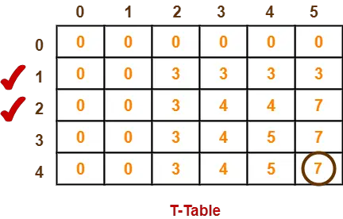
0-1 Knapsack Problem Contd…
Similarly, compute all the entries.
After all the entries are computed and filled in the table, we get the following table-
The last entry represents the maximum possible value that can be put into the knapsack.
So, maximum possible value that can be put into the knapsack = 7.
Identifying Items To Be Put Into Knapsack-
Following Step-04,
We mark the rows labelled “1” and “2”.
Thus, items that must be put into the knapsack to obtain the maximum value 7 are-
Item-1 and Item-2

Slide 61
Bellman Ford Algorithm
Bellman ford algorithm is a single-source shortest path algorithm. This algorithm is used to find the shortest distance from the single vertex to all the other vertices of a weighted graph. There are various other algorithms used to find the shortest path like Dijkstra algorithm, etc. If the weighted graph contains the negative weight values, then the Dijkstra algorithm does not confirm whether it produces the correct answer or not. In contrast to Dijkstra algorithm, bellman ford algorithm guarantees the correct answer even if the weighted graph contains the negative weight values.
Rule of this algorithm
We will go on relaxing all the edges (n - 1) times where,
n = number of vertices

Slide 62
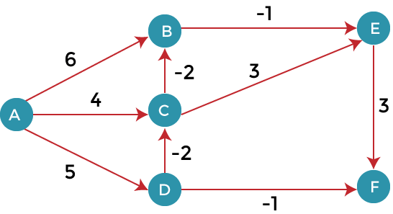
Bellman Ford Algorithm
Consider the below graph:
As we can observe in the above graph that some of the weights are negative. The above graph contains 6 vertices so we will go on relaxing till the 5 vertices. Here, we will relax all the edges 5 times. The loop will iterate 5 times to get the correct answer. If the loop is iterated more than 5 times then also the answer will be the same, i.e., there would be no change in the distance between the vertices.
Relaxing means:
If (d(u) + c(u , v) < d(v))
d(v) = d(u) + c(u , v)

Slide 63
Bellman Ford Algorithm
Consider the below graph:

Slide 64
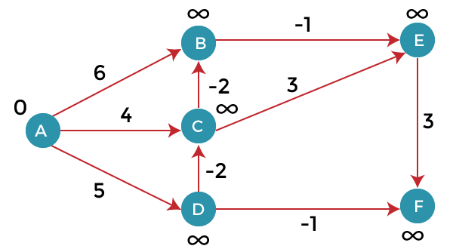
Bellman Ford Algorithm
To find the shortest path of the above graph, the first step is note down all the edges which are given below:
(A, B), (A, C), (A, D), (B, E), (C, E), (D, C), (D, F), (E, F), (C, B)
Let's consider the source vertex as 'A'; therefore, the distance value at vertex A is 0 and the distance value at all the other vertices as infinity shown as below:
Since the graph has six vertices so it will have five iterations.

Slide 65
Bellman Ford Algorithm
First iteration
Consider the edge (A, B). Denote vertex 'A' as 'u' and vertex 'B' as 'v'. Now use the relaxing formula:
d(u) = 0
d(v) = ∞
c(u , v) = 6
Since (0 + 6) is less than ∞, so update
d(v) = 0 + 6 = 6
Therefore, the distance of vertex B is 6.
Consider the edge (A, C). Denote vertex 'A' as 'u' and vertex 'C' as 'v'. Now use the relaxing formula:
d(u) = 0
d(v) = ∞
c(u , v) = 4
Since (0 + 4) is less than ∞, so update, d(v) = 0 + 4 = 4
Therefore, the distance of vertex C is 4.
If (d(u) + c(u , v) < d(v))
d(v) = d(u) + c(u , v)

Slide 66
Bellman Ford Algorithm
First iteration
Consider the edge (A, D). Denote vertex 'A' as 'u' and vertex 'D' as 'v'. Now use the relaxing formula:
d(u) = 0
d(v) = ∞
c(u , v) = 5
Since (0 + 5) is less than ∞, so update
d(v) = 0 + 5 = 5
Therefore, the distance of vertex D is 5.
Consider the edge (B, E). Denote vertex 'B' as 'u' and vertex 'E' as 'v'. Now use the relaxing formula:
d(u) = 6
d(v) = ∞c(u , v) = 4
c(u , v) = -1
Since (6 - 1) is less than ∞, so update
d(v) = 6 - 1= 5
Therefore, the distance of vertex E is 5
If (d(u) + c(u , v) < d(v))
d(v) = d(u) + c(u , v)

Slide 67
Bellman Ford Algorithm
Consider the edge (C, E). Denote vertex 'C' as 'u' and vertex 'E' as 'v'. Now use the relaxing formula:
d(u) = 4
d(v) = 5
c(u , v) = 3
Since (4 + 3) is greater than 5, so there will be no updation. The value at vertex E is 5.
Consider the edge (D, C). Denote vertex 'D' as 'u' and vertex 'C' as 'v'. Now use the relaxing formula:
d(u) = 5
d(v) = 4
c(u , v) = -2
Since (5 -2) is less than 4, so update, d(v) = 5 - 2 = 3
Therefore, the distance of vertex C is 3.
Consider the edge (D, F). Denote vertex 'D' as 'u' and vertex 'F' as 'v'. Now use the relaxing formula:
d(u) = 5
d(v) = ∞
c(u , v) = -1
Since (5 -1) is less than ∞, so update,
d(v) = 5 - 1 = 4
Therefore, the distance of vertex F is 4.

Slide 68
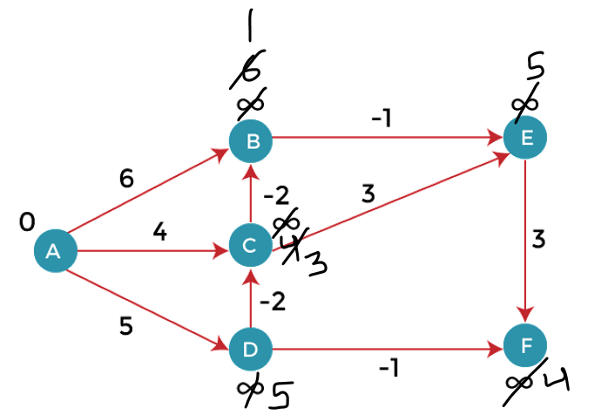
Bellman Ford Algorithm
Consider the edge (E, F). Denote vertex 'E' as 'u' and vertex 'F' as 'v'. Now use the relaxing formula:
d(u) = 5
d(v) = ∞
c(u , v) = 3
Since (5 + 3) is greater than 4, so there would be no updation on the distance value of vertex F.
Consider the edge (C, B). Denote vertex 'C' as 'u' and vertex 'B' as 'v'. Now use the relaxing formula:
d(u) = 3
d(v) = 6
c(u , v) = -2
Since (3 - 2) is less than 6, so update
d(v) = 3 - 2 = 1
Therefore, the distance of vertex B is 1.
Now the first iteration is completed.

Slide 69
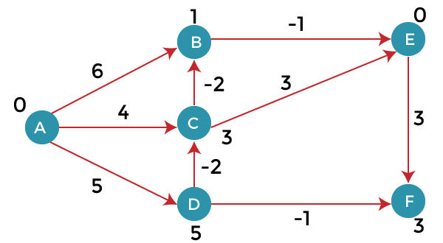
Bellman Ford Algorithm
Second iteration:
In the second iteration, we again check all the edges. The first edge is (A, B). Since (0 + 6) is greater than 1 so there would be no updation in the vertex B.
The next edge is (A, C). Since (0 + 4) is greater than 3 so there would be no updation in the vertex C.
The next edge is (A, D). Since (0 + 5) equals to 5 so there would be no updation in the vertex D.
The next edge is (B, E). Since (1 - 1) equals to 0 which is less than 5 so update:
d(v) = d(u) + c(u, v)
d(E) = d(B) +c(B , E) = 1 - 1 = 0
The next edge is (C, E). Since (3 + 3) equals to 6 which is greater than 0 so there would be no updation in the vertex E.
The next edge is (D, C). Since (5 - 2) equals to 3 so there would be no updation in the vertex C.
The next edge is (D, F). Since (5 - 1) equals to 4 so there would be no updation in the vertex F.
The next edge is (E, F). Since (5 + 3) equals to 8 which is greater than 4 so there would be no updation in the vertex F.
The next edge is (C, B). Since (3 - 2) equals to 1` so there would be no updation in the vertex B.

Slide 70
Bellman Ford Algorithm
Third iteration
We will perform the same steps as we did in the previous iterations. We will observe that there will be no updation in the distance of vertices.
The following are the distances of vertices:
A: 0
B: 1
C: 3
D: 5
E: 0
F: 3
Time Complexity
The time complexity of Bellman ford algorithm would be O(E|V| - 1)

Slide 71
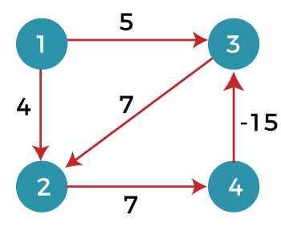
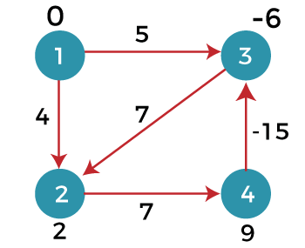
Bellman Ford Algorithm
Drawbacks of Bellman ford algorithm
The bellman ford algorithm does not produce a correct answer if the sum of the edges of a cycle is negative. Consider the below graph.
After 3 iteration: The graph should give optimal solution
4th iteration
The first edge is (1, 3). Since (0 +5) equals to 5 which is greater than -6 so there would be no change in the vertex 3.
The next edge is (1, 2). Since (0 + 4) is greater than 2 so there would be no updation.
The next edge is (3, 2). Since (-6 + 7) equals to 1 which is less than 2 so update:
d(v) = d(u) + c(u, v)
d(2) = d(3) +c(3, 2)
= -6 + 7 = 1
In this case, the value of the vertex is updated. So, we conclude that the bellman ford algorithm does not work when the graph contains the negative weight cycle.
Therefore, the value at vertex 2 is 1.

Slide 72
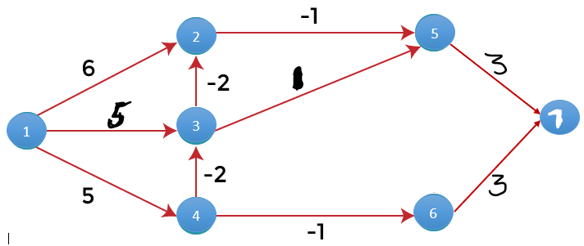
Bellman Ford Algorithm
Here we have 7 vertices. Relax for n-1 times. i.e-7-1=6 times
To find the shortest path of the above graph, the first step is note down all the edges which are given below:
(1,2), (1,3), (1,4), (2,5), (3,2), (3,5), (4,3), (4,6), (5,7), (6,7)
Now relax all these edges 6 times i.e., n-1 times.

Slide 73
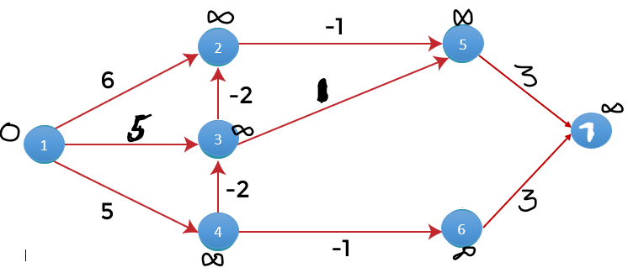
Bellman Ford Algorithm
Let's consider the source vertex as 'A'; therefore, the distance value at vertex A is 0 and the distance value at all the other vertices as infinity shown as below:
Source u=1------Putting in formula
Relaxing means:
If (d(u) + c(u , v) < d(v))
d(v) = d(u) + c(u , v)

Slide 74
Travelling Salesperson Problem(TSP)
Sometimes Dynamic Programming can be used to find relatively fast, but still exponential algorithms.
Travelling Salesman Problem
Given: A distance table between n cities.
Problem: Find a shortest tour.
A tour here is required to visit each city exactly once and return to the city of origin. The cost is the sum of the edge costs.
https://www.youtube.com/watch?v=XaXsJJh-Q5Y

Slide 75
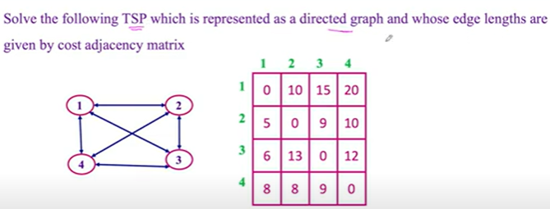
Travelling Salesperson Problem(TSP)
Starting Vertex--1

Slide 76
References
Introduction to Algorithms by Coreman, Leiserson, Rivest, Stein.
Fundamentals of Algorithms by Ellis Horwitz, Sartaj Sahni, Sanguthevar Rajasekaran
https://www.youtube.com/watch?v=052VkKhIaQ4

Slide 77
THANK YOU
For any Queries-
E-Mail: gurpreetkaur.uic@cumail.in

